Slide 1
Security Operations and Administration

Slide 2
The Waterfall Model
Requirement Gathering and Analysis
System Design
Implementation
Integration and testing
Deployment of system
Maintenance

Slide 3
Benefits and Drawbacks
Benefits
Ease of use and management
Broad scope
Detailed specificity of systems documentation
Drawback
Assumes a static set of requirements captured before design and coding phases begin

Slide 4
Requirements Definition
Functional and nonfunctional requirements are documented
Security requirements may be incorporated within the nonfunctional requirements specification

Slide 5
System Design
Design may first be laid out in a general design document
Design walkthroughs are often held to review the design before construction

Slide 6
Implementation
Software programming is completed in this phase
Functional design specifications are translated into executable processes using one or more programming languages

Slide 7
Integration
Integration occurs when multiple functional units of code or modules that form the application are compiled and run together

Slide 8
Testing
Testing is not a separate phase of waterfall development projects
Different types of testing and debugging occur from construction to installation and beyond
Unit testing
Integration testing
System testing

Slide 9
Deployment of System
When the application has been system tested, it is installed into a controlled environment for quality assurance and user acceptance testing
At this stage, the application is considered to be in its final form

Slide 10
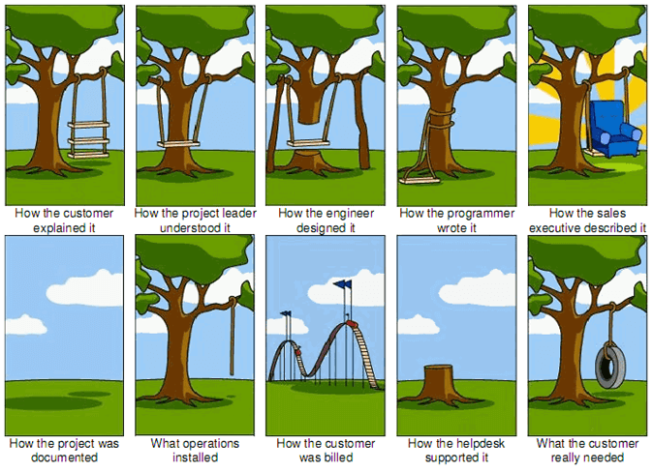

Slide 11
Maintenance
Changes in business needs and practices, newly discovered bugs and vulnerabilities, and changes in the technical environment all necessitate changes to production applications

Slide 12
Additional Application Development Methods
Spiral model
Extreme Programming and Rapid Application Development
Agile Development
Component Development and Reuse

Slide 13
Open Web Application Security Project (OWASP) Top Ten
The OWASP provides a freely available listing of the top vulnerabilities found in web applications

Slide 14
Guidelines for Developers
Authentication
Authorization
Session management
Encryption of sensitive data
Input validation
Disallow dynamic queries
Out-of-band confirmation
Avoid exposing system information
Error handling

Slide 15
Device Management
Hardware Asset Management (HWAM)
Software Inventory Management (SWAM)
Configuration Setting Management (CSM)
Vulnerability (Patch) Management (VUL)

Slide 16
The SSCP’s Challenge
Many companies consider Hardware Asset Management (HAM)/Software Asset Management (SAM) to be an unnecessary expense

Slide 17


Slide 18
Secure Information Storage
File/folder encryption is simpler and faster to implement
Presents exposures if the operating system or user of the machine writes data to an unencrypted location
Full disk encryption protects the entire contents of a laptop’s hard drive

Slide 19
Database Encryption
Database size
Performance
Application compatibility

Slide 20
Data Scrubbing
Wholesale replication of data from production to test is a common practice
Wholesale replication of security controls from production to test is not
The goal of data sanitization is to obfuscate sensitive data

Slide 21
Data Deduplication
Deduplication is a process that scans the entire collection of information looking for similar chunks of data that can be consolidated

Slide 22
Managing Encryption Keys
Key management refers to the set of systems and procedures used to securely generate, store, distribute, use, archive, revoke, and delete keys
Key management policy identifies roles, responsibilities, and security requirements

Slide 23
Considerations
Roles and responsibilities
Key generation and storage
Distribution
Expiration
Revocation and destruction
Audit and tracking
Emergency management

Slide 24
Information Rights Management (IRM)
IRM functions to assign specific properties to an object such as how long the object may exist, what users or systems may access it, and if any notifications need to occur when the file is opened, modified, or printed

Slide 25
Data Retention and Disposal
Record retention policy and schedule
Handling procedures

Slide 26
Shredders
Strip-cut shredders
Cross-cut shredders
Particle-cut shredders
Hammermills
Granulators

Slide 27
Destruction of Magnetic Media
Methods of destroying data contained on magnetic media include various techniques for clearing or sanitizing data
Cloud service providers should support eradication of data when deleted

Slide 28
Disclosure Controls: Data Leakage Prevention
Data discovery
Labeling
Policy creation
Content detection/monitoring
Prevention or blocking
Reporting

Slide 29
Technical Controls
Technical controls are security controls that the computer system executes
The controls can:
Provide automated protection from unauthorized access or misuse
Facilitate detection of security violations
Support security requirements for applications and data

Slide 30
Operational Controls
Operational Control policies address process-based security controls implemented and executed by people
Two types of operational security problems:
Accidental misconfigurations
Deliberate misconfigurations

Slide 31
Operational Solutions
Operational security policy
Change management process
Access control
Authorization
Dual control
Secure and verify
Automation

Slide 32
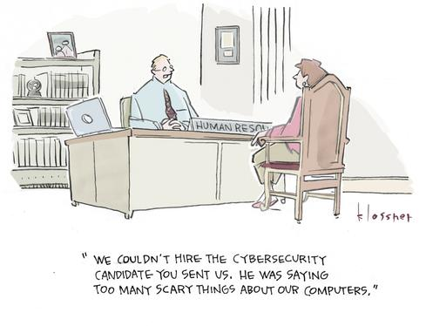

Slide 33
Subject-Specific Security Policies
Subject-specific security policies typically address a limited area of risk related to a particular class of assets, type of technology, or business function
E-Mail and Internet Usage Policies
Antivirus Policy
Remote Access Policy
Information Classification Policy
Encryption Policies
Document Format Policy

Slide 34
Components of a Security Policy
State the objective
Draft the policy specifics
Identify methods for measurement and enforcement
Compliance with policy expectations
Communication
Periodic review

Slide 35
Standards and Guidelines
Standard
A formal, documented requirement that sets uniform criteria for a specific technology, configuration, nomenclature, or method
Guidelines
Recommended practices to be followed to achieve a desired result
Not mandatory

Slide 36
Procedures
Procedures are step-by-step instructions for performing a specific task or set of tasks
Ensure consistent and repeatable results
Provide instruction to those who are unfamiliar with how to perform a specific process
Provide assurance to management and auditors that policies are being enforced in practice

Slide 37
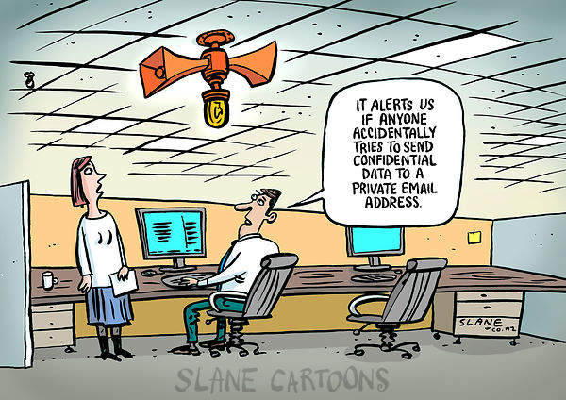

Slide 38
Release Management Policy
The conditions that must be met for an application or component to be released to production
Roles and responsibilities for packaging, approving, moving, and testing code releases
Approval and documentation requirements

Slide 39
Release Management
Controls the release of applications, updates, and patches to the production environment
Goal:
To provide assurance that only tested and approved application code is promoted to production or distributed for use

Slide 40
Release Manager
Responsible for planning, coordination, implementation, and communication of all application releases
Assures that all documentation and communication regarding the release are prepared and distributed

Slide 41
Release Management Process
The release management process actually begins with the QA testing environment
Once user acceptance testing is complete, the application is packaged for deployment to the production or preproduction environment and the final package is verified

Slide 42
Release Management Tools
Role-based access control
Approval checking and rejection of unapproved packages
Component verification tools
Rollback and demotion facilities
Auditing and reporting tools

Slide 43
Configuration Management (CM)
Manage configuration changes so that they are appropriately approved and documented, so that:
The integrity of the security state is maintained
Disruptions to performance and availability are minimized

Slide 44
CM System Goals
Baseline hardware, software, and firmware configurations
Design, installation, and operational documentation
Changes to the system since the last baseline
Software test plans and results

Slide 45
Automated Configuration Management Tools
Most development platforms include:
Source code comparators
Comment generators
Version checkers
Check in/check out functions

Slide 46
Hardware Inventory
Make
Model
MAC addresses
Serial number
Operating system or firmware version
Location
BIOS and other hardware-related passwords
Assigned IP address if applicable
Organizational property management label
Owner

Slide 47
Software Inventory
Software name
Software vendor
Keys or activation codes
Type of license and for what version
Number of licenses

Slide 48
Software Inventory
License expiration
License portability
Organizational software librarian or asset manager
Organizational contact for installed software
Upgrade, full or limited license

Slide 49
Configuration Lists
A configuration list for each device should be maintained
Devices such as firewalls, routers, and switches can have hundreds or thousands of configuration possibilities

Slide 50
Configuration Management for Operating Systems
Operating systems and applications also require configuration management
Organizations should have configuration guides and standards for each operating system and application implementation

Slide 51
Control
Control mechanisms govern:
Change requests
Approvals
Change propagation
Impact analysis
Bug tracking
Propagation of changes

Slide 52
Auditing
Auditing is a process of logging, reviewing, and validating the state of CIs in the CMDB, ensuring that:
All changes are appropriately documented
A clear history of changes is retained
Compares CMDB with the actual system configuration

Slide 53
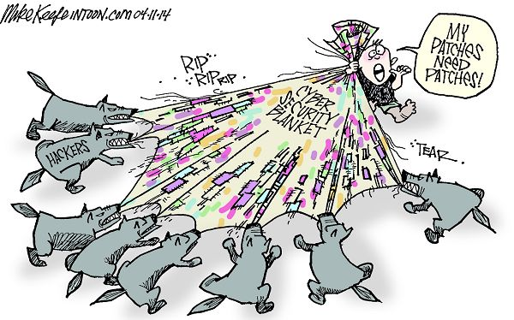

Slide 54
Security Impact Assessment
The analysis conducted by qualified staff within an organization to determine the extent to which changes to the information system affect the security posture of the system

Slide 55
System Architecture/ Interoperability of Systems
Interoperability:
The extent to which systems and devices can exchange data and interpret that shared data
For two systems to be interoperable, they must be able to exchange data and subsequently present that data such that a user can understand it

Slide 56
Patch Management Process
Acquisition
Testing
Approval
Packaging
Deployment
Verification

Slide 57
Security Awareness Training
Security awareness seeks to reduce the risk related to human error

Slide 58
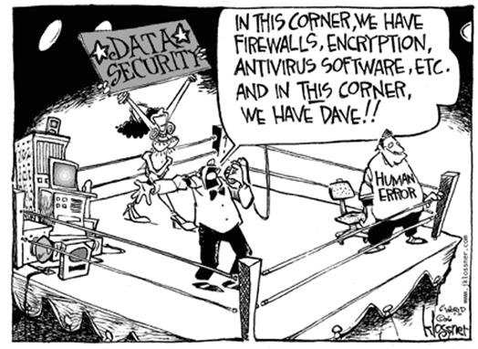

Slide 59
Critical Success Factors
Senior management support
Cultural awareness
Set communication goals and build a strategy to meet these goals
Taking a change management approach
Measurement

Slide 60
Potential Training Topics
Labeling and handling of sensitive information
Appropriate use policies for e-mail, Internet, and other services
Customer privacy laws, policies, and procedures
Detecting and reporting security incidents
Protecting intellectual property and copyright

